Slide 1


Slide 2

Topics
What is EC2
EC2 Options
EC2 instance type
What is EBS?
EBS Volumes Types
Exam Tip

Slide 3
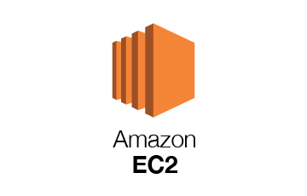
What is EC2?
Amazon Elastic Compute Cloud (EC2) is a web service that provides resizable compute capacity in the cloud.
It's just a virtual machines in the cloud and it reduces the time required to obtain and boot new server instance to minutes, allowing you to quickly scale capacity, both up and down, as your computing requirements change.

Slide 4
What is EC2?
Amazon EC2 changed the economics of cloud computing by allowing you to pay for the capacity that you use rather than previously when you wanted to go out and buy physical servers.
Amazon EC2 provides developers the tools to build failure resilient applications and isolate themselves from common failure scenarios.

Slide 5
EC2 Options
On-Demand :- Allows you to pay a fixed rate by the hour or even by the second with no commitment.
Reserved :- Provide you with a capacity reservation and offer a significant discount on the hourly charge for an instance, 1 year or 3-year terms
Spot :- Enables you to bid a price and you can choose whatever price that you want for instance capacity, providing for even greater savings if your application have flexible start and end times.
Dedicated Hosts:- Physical EC2 serve dedicated for your use. They can help you reduce costs by allowing you to use your existing server bond software licenses.

Slide 6
On Demand
Perfect for users that want the low cost and flexibility of AWS EC2 without any up-front payments or long-term commitments.
Applications with short term , spiky or unpredictable workloads that cannot be interrupted
Applications being developed or tested on Amazon EC2 for the first time

Slide 7
Reserved instances
Applications with Steady State or very predictable usage
Applications that require a reserved capacity
Users can make up-front payments to reduce the total computing costs even further.
Standard reserved instances - up to 75 percent off the on demand
Convertible reserved instances - up to 54% percent off the on demand. These basically have the capability to change the attributes of the reserved instances so long as the exchange results in the creation of reserved instances of equal or greater value.
Scheduled reserved instances :- These are available to launch within a specific time window that you reserve. This option allows you to match your capacity reservation to predictable recurring schedule that only requires a fraction of a day, week or a month.

Slide 8
Spot instances
Applications that have flexible start and end times
Applications that are only feasible at very low compute prices.
Users with an urgent need for large amounts of additional computing capacity
If a Spot instance is terminated by Amazon EC2, you will not be charged for a partial hour of usage. However, if you terminated the instance yourself, you will be charged for the complete hour in which the instance ran

Slide 9
Dedicated hosts
Useful for regulatory requirements that may not support multitenant virtualization.
Great for licensing which does not support multi-tenancy or cloud deployments Can be purchased On-Demand
Can be purchased as a reservation up to 70% off the On-Demand price

Slide 10
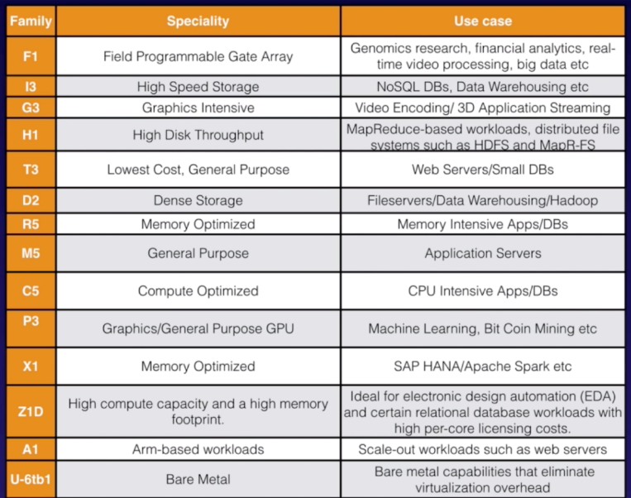
EC2 Instance Type

Slide 11

EC2 Instance Type
How to Remember FIGHT DR MCPXZ AU
F – FPGA
I – IOPS
G – Graphics
H – High disk throughput
T – cheap general purpose
D – Density
R – RAM
M – Main choice general purpose apps
C – Compute
P – Picture (graphics)
X – Extreme memory
Z – Z-factor. Extreme memory and CPU
A – ARM based instances
U – Bare metal

Slide 12
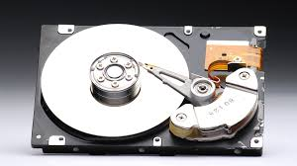
What is EBS?
Amazon EBS (Elastic Block Service) allows you to create storage volumes and attach them to EC2 instances. Once attached, you create a file system on top of these volumes, you can run a database, you can install application, or you could store files or use it any way that you would use a block device.
EBS volume are placed in a specific Availability Zone, where they are automatically replicated to protect you from the failure of a single component.

Slide 13
EBS Volumes Types
General purpose SSD(GP2)
General purpose, balances both price and performance.
Ratio of 3 IOPS per gig with up to 13,000 IOPS and the ability to burst up to 3000 IOPS for extended periods of time for volumes at 3334 GiB and above.
Provisioned IOPS SSD (IO1)
Designed for I/O intensive applications such as large relational or NoSQL databases
Use this if you need more than 16,000 IOPS.
Can provision up to 64,000 IOPS per volume.

Slide 14
EBS Volumes Types
Magnetic disks
Throughput Optimized HDD(ST1)
Big data
Data warehouses
Load processing
Cannot be a boot volume
Cold HDD(SC1)
Lowest cost storage for infrequently access workloads
file server
Cannot be a boot volume
Magnetic(Standard)
Lowest cost per gigabyte of all EBS volume types that is bootable.
Only magnetic volume that is bootable.
Magnetic volumes are basically ideal for workloads where data is accessed infrequently and applications where the lowest storage cost is important.

Slide 15
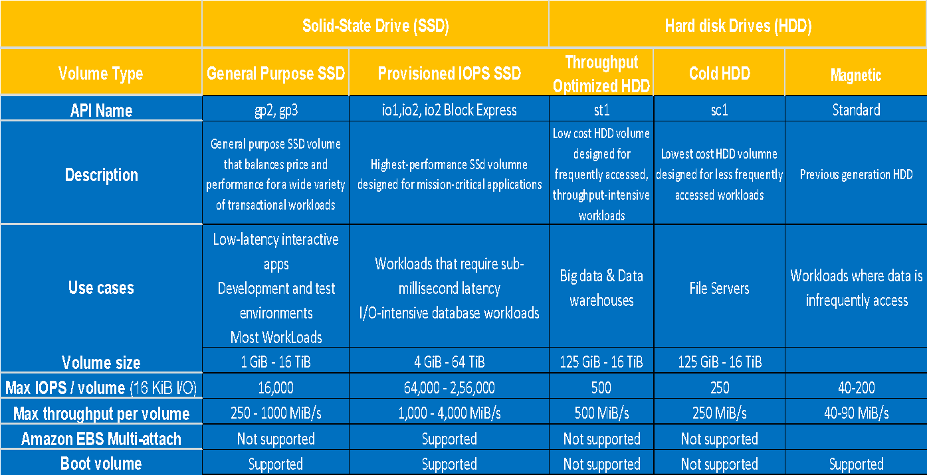
EBS Volumes Types

Slide 16
Exam Tips:
On-Demand :- Allows you to pay a fixed rate by the hour or even by the second with no commitment.
Reserved :- Provide you with a capacity reservation and offer a significant discount on the hourly charge for an instance, 1 year or 3-year terms
Spot :- Enables you to bid a price and you can choose whatever price that you want for instance capacity, providing for even greater savings if your application have flexible start and end times.
Dedicated Hosts:- Physical EC2 serve dedicated for your use. They can help you reduce costs by allowing you to use your existing server bond software licenses.

Slide 17
Exam Tips:
How to Remember FIGHT DR MCPXZ AU
F – FPGA
I – IOPS
G – Graphics
H – High disk throughput
T – cheap general purpose
D – Density
R – RAM
M – Main choice general purpose apps
C – Compute
P – Picture (graphics)
X – Extreme memory
Z – Z-factor. Extreme memory and CPU
A – ARM based instances
U – Bare metal

Slide 18
Exam Tips:
General purpose SSD(GP2): balances both price and performance.
Provisioned IOPS SSD (IO1): highest-performance SSD volume for mission-critical low-latency or high-throughput workloads
Magnetic disks
Throughput Optimized HDD(ST1): low-cost HDD volume designed for frequently accessed, throughput-intensive workloads
Cold HDD(SC1): lowest cost storage for infrequently access workloads
Magnetic(Standard): Previous Generation.
Can be boot volume.

Slide 19
Thank you

